Slide 1
CSE 3200
SYSTEM DEVELOPMENT PROJECT
Document Verification using
Public Blockchain

Slide 2

Supervisor:
Dr. Kazi Md. Rokibul Alam Professor, Dept. of CSE
Khulna University of Engineering & Technology, Khulna 9203, Bangladesh
Submitted by:
Resam Zaha
(Roll - 1807036)
Sourav Majumder (Roll - 1807099)
2

Slide 3


OBJECTIVES
To study the applicability of decentralized applications for document verification.
To develop and implement document verification applications based on the public Blockchain platform.
To ensure data integrity.
3

Slide 4

INTRODUCTION
A certificate is a proof of graduate qualification and can be used to apply for a university
Whenever applicants apply for the university, he/she has to upload verified certificates, which is time-consuming
This is where our website comes .
4

Slide 5

WHAT IS BLOCKCHAIN
Blockchain is a shared, immutable, distributed, ledger.
If we write something in the block we can't remove those. This is immutable.
The thing we report on the block is called a ledger. Like ledger book
When we add a block it will update the chain. Then this chain of blocks will be distributed among the systems.
Data will be shared among the blocks.
5

Slide 6

WHAT IS ETHEREUM
Ethereum is an open-source blockchain-based platform.
Ethereum has three nodes (Full node, Light node, Archive node)
An Ethereum account is an entity with an ether(ETH) balance that can send or receive transactions on Ethereum.
6

Slide 7

WHAT IS EVM
EVM is Ethereum Virtual Machine.
They are designed to serve as a runtime environment for smart contracts based on Ethereum.
Instruct the EVM to execute applications by using a high-level language called Solidity, which is used for developing smart contract.
7

Slide 8

WHAT IS IPFS
Interplanetary File System(IPFS) is a peer-to-peer, decentralized, and distributed file system.
IPFS uses DHT(distributed hash table) and Merkle DAG(directed acyclic graph) data structures.
It uses a protocol similar to BitTorrent to decide how to move data around the network.
8

Slide 9




SCOPE
BLOCKCHAIN-BASED ON
ETHEREUM PLATFORM
TECHNOLOGY
STUDENTS
USER
9

Slide 10
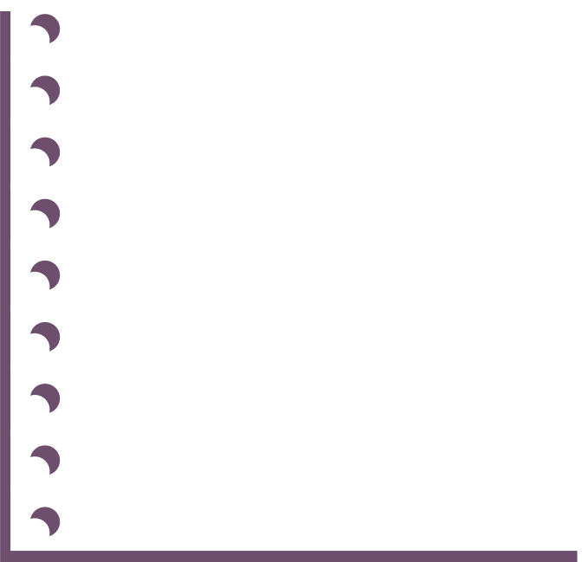
SOFTWARE REQUIREMENT
Remix IDE
Metamask
Ganache
Truffle
Next.js
TailwindCSS
Front-end
Back-end
10

Slide 11



ARCHITECTURE OF PROPOSED SYSTEM
decentralized
application
(dApp)
Smart contract
Ethereum
blockchain
Front-end
Back-end
11

Slide 12



FEATURES
Student can apply to the university using verified files and can view their files
Admin can upload single/multiple files
upload file
show file
verify file
Student can verify their files
12

Slide 13

IMPLEMENTATION
Deployed our smart contract using truffle framework.
Generated public key using ganache.
Used Next.js to create the website.
Used web3.js to contact the contract.
Implemented Add Documents, Verify Documents, & Show documents functionality.
13

Slide 14
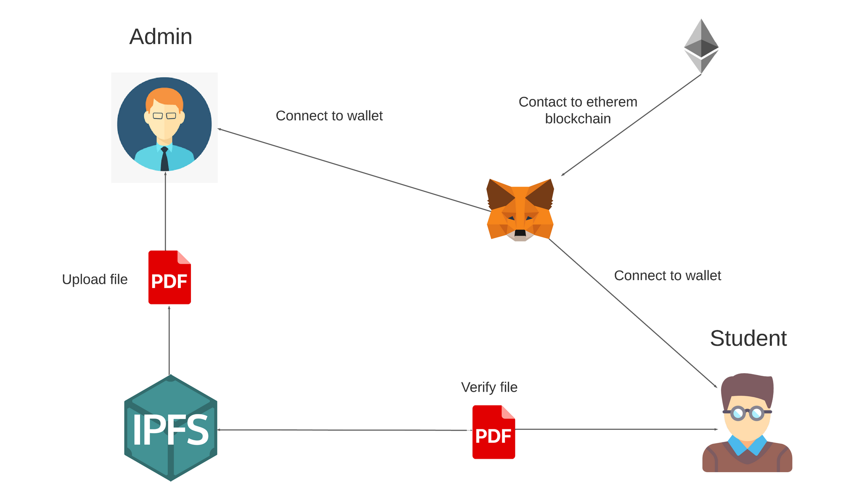
WORKFLOW
14

Slide 15

RESULT & ANALYSIS
The user interface of the website was manually created with user friendliness in mind.
A new user, who is unfamiliar with Ethereum or blockchain, can easily use it for any professional work or other purpose.
The website is very easy to use and suitable for everyone functionality.
15

Slide 16

WHY DO WE USE BLOCKCHAIN?
Identity is stored in more secured yet easily verifiable way.
Self sovereign identity
Company can't sell your data or use data without your permission.
Prevent fraudulent identity by preventing duplicate ID.
16

Slide 17
LIMITATIONS
Because of the public blockchain, we could not ensure data privacy.
Potentially less secure as fewer nodes could be more easily compromised.
IPFS will clear the files if small nodes are seeding the file
17

Slide 18
FUTURE PLAN
Enabling students to verify more than one file at a time
Making wallet manager user-friendly.
Ensuring data privacy and security
18

Slide 19
CONCLUSION
The primary goal of this project is to verify the user's document.
We have used blockchain to make sure data integrity.
We have used IPFS to have decentralized storage.
The project's primary goal was effectively accomplished.
The project is user-friendly and efficient
19

Slide 20
REFERENCE
https://www.blockchain.com/
https://web3.storage/
https://metamask.io/
https://ethereum.org/en/
20

Slide 21
THANK YOU!

Slide 22
Q/A

